Slide 1



Federated Maps to Enable the Spatial Web
Sagar Bharadwaj
www.open-flame.com
Notes:
I am Sagar and I am going to present OpenFLAME, a federated spatial naming system that we are building at Carnegie Mellon University.

Slide 2
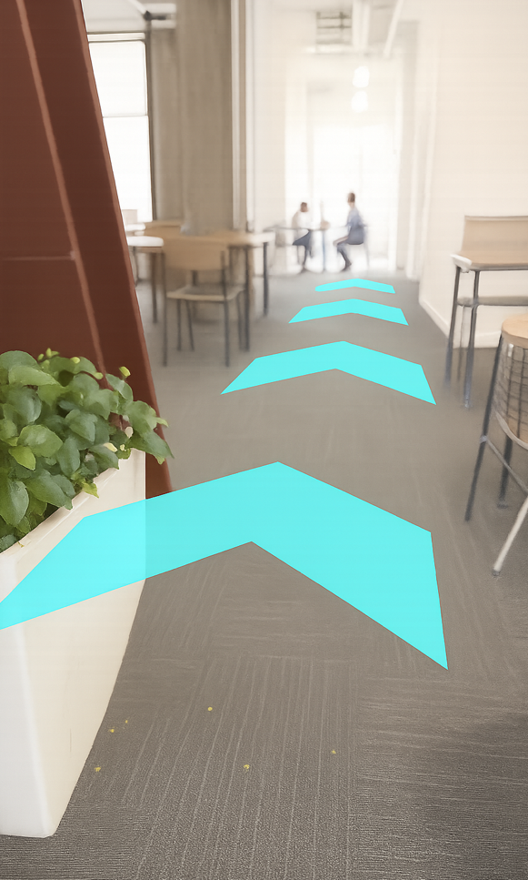
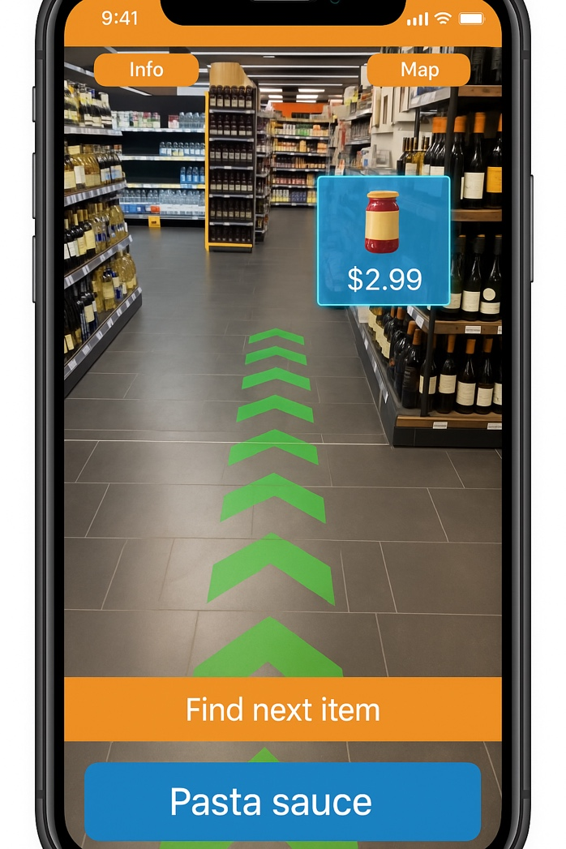
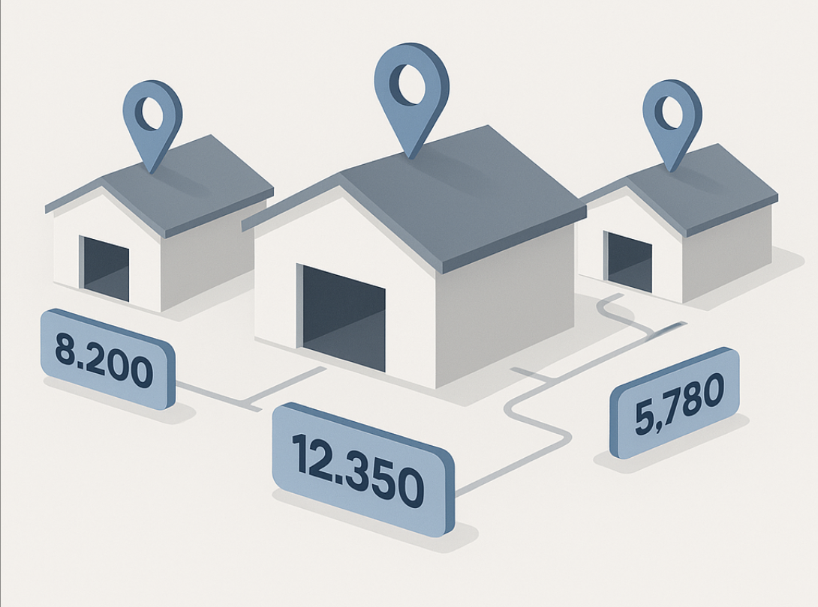
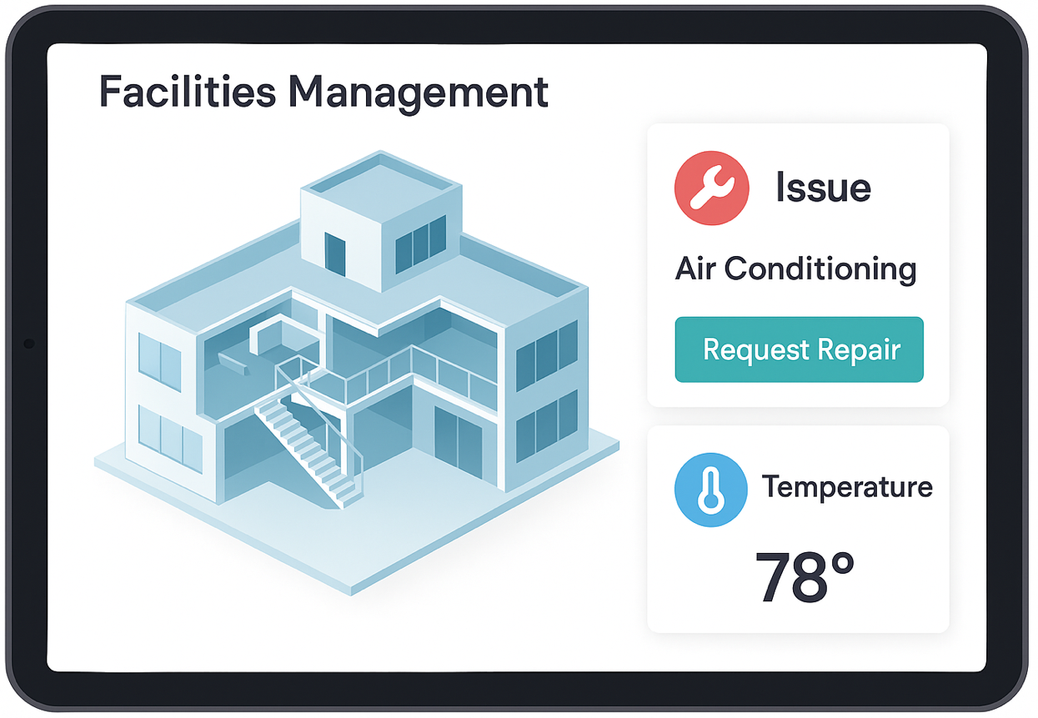
Examples of Spatial Applications
3D indoor navigation
Inventory management
AR shopping
Facilities management
Notes:
Recently we have been seeing a push to develop a new class of applications called Spatial Applications. Spatial applications are applications whose data and logic are tied to physical spaces. 3D indoor Navigation is a familiar example intuitive to all of us. But there are wide range of spatial applications from Inventory management…

Slide 3


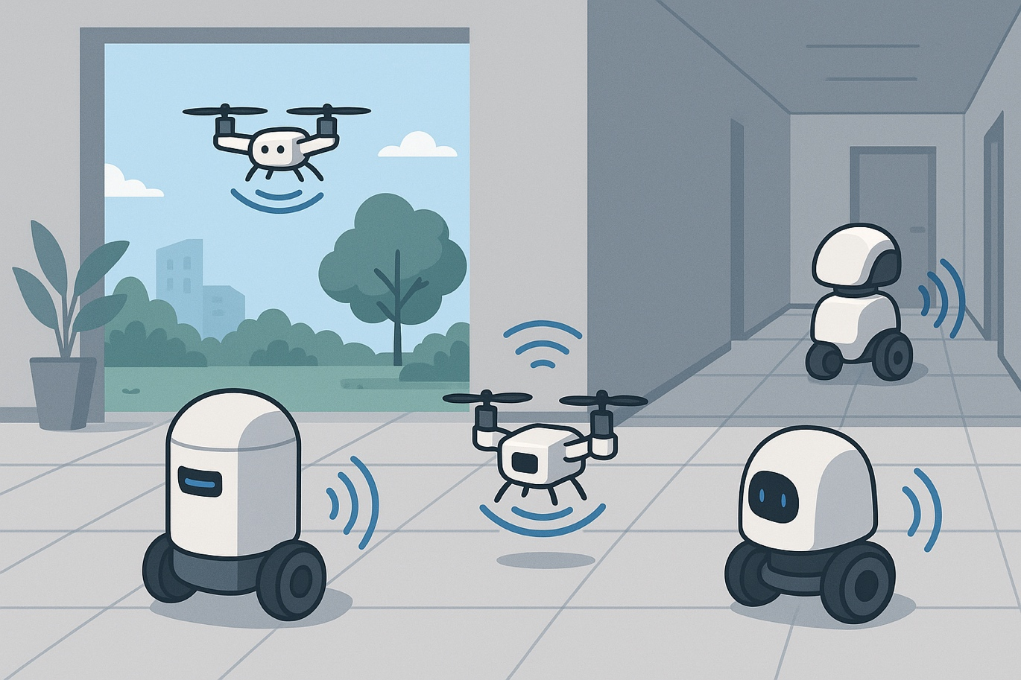

Examples of Spatial Applications
15-744 Grad Networks Classroom
Fine-grained location search
Placing AR content
Autonomous Robots
Indoor 3D navigation
Inventory management
AR shopping
Facilities management
Notes:
…To Augmented reality and autonomous robot.

Slide 4
Examples of Spatial Applications
15-744 Grad Networks Classroom
Spatial Web
Fine-grained location search
Placing AR content
Autonomous Robots
Indoor 3D navigation
Inventory management
AR shopping
Facilities management
Notes:
Perhaps, we think that the next generation of the web is going to be the spatial web which would host such spatial applications.
As part of the systems community, we believe that we need to start building the underlying systems infrastructure that is needed to enable such applications.

Slide 5
Motivating Example: Navigation
Notes:
To make things clearer, let us first look at a motivating example application that familiar to all of us, navigation.

Slide 6




Example Application: Shopping Navigator
Sagar’s Office, Carnegie Mellon
HDMI Cable, Target
Notes:
Let’s say I am giving a talk at CMU in 30 mins, and I realize I need to buy a cable to connect my laptop to the projector. So now I need to run to Target and I need an application that can take me from my office to the shelf at Target that stocks HDMI cables.

Slide 7
Example Application: Shopping Navigator
Sagar’s Office, Carnegie Mellon
HDMI Cable, Target
We need a system to associate this name with a real-world location
…or a Spatial Naming System a.k.a Map
Notes:
To enable such applications, we need a system that associates such strings, or names, with real-world locations.
In other words, we need a spatial naming system, also known as a map. Because that’s what maps do, assign names to real-world locations.

Slide 8
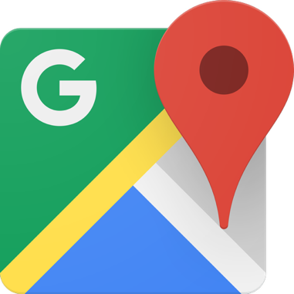
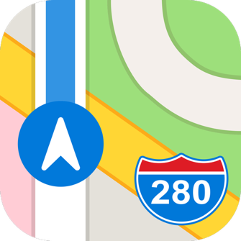

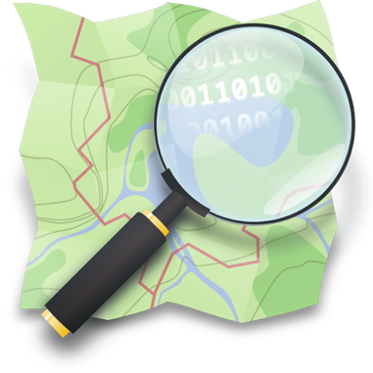
Example Application: Shopping Navigator
Sagar’s Office, Carnegie Mellon
HDMI Cable, Target
Today, to build such an application, we would use a digital world map
Google Maps
Apple Maps
mapbox
OpenStreetMap
Notes:
To build an application like this today, you would one of the digital world maps. Google maps, Apple maps, mapbox, openstreetmap are some examples.

Slide 9
Example Application: Shopping Navigator
Sagar’s Office, Carnegie Mellon
HDMI Cable, Target
Today’s maps answer only a part of the problem
Google Maps
Apple Maps
mapbox
OpenStreetMap
Notes:
However, today’s maps can only answer a part of the problem.

Slide 10

Example Application: Shopping Navigator
Sagar’s Office, Carnegie Mellon
HDMI Cable, Target
Notes:
In this example, they probably know the location of Carnegie Mellon and Target. But they do not know the location of my desk at CMU, or the location of the shelf with the cable at Target.

Slide 11
We need a ubiquitous Spatial Naming System to enable emerging Spatial Applications
Notes:
So what we need is a ubiquitous spatial naming system with the potential to have coverage across all spaces, across indoor, outdoor, public and private spaces to enable such spatial applications.

Slide 12
Why do maps today not have ubiquitous coverage?
Indoor data collection is hard
Crowdsourcing on a central system is not the right way to scale
Notes:
Before jumping to the solution, First let us understand why the problem exists. Why do maps today not have coverage across all spaces.

Slide 13
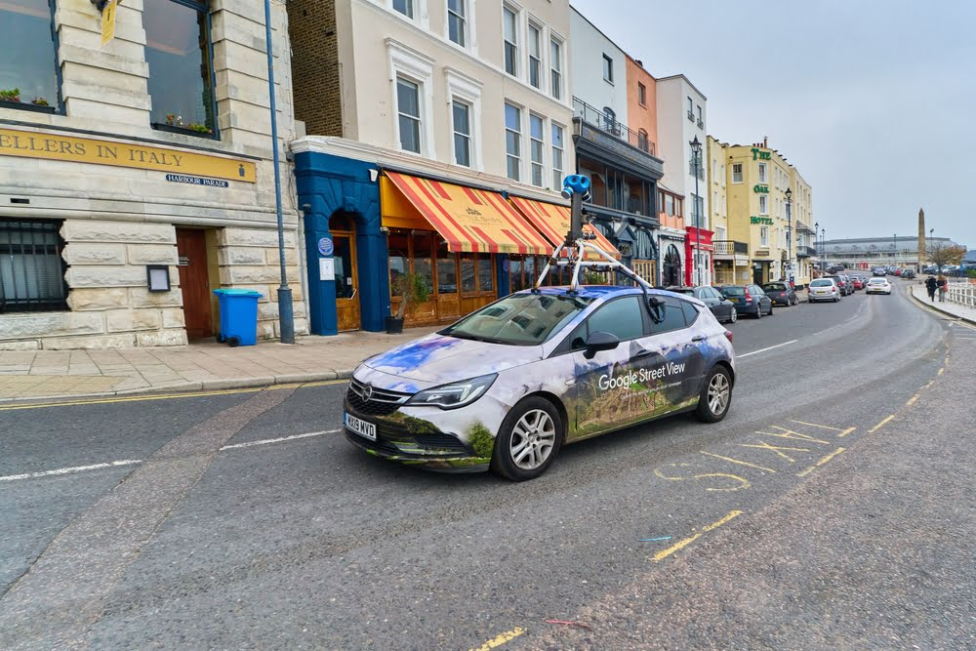
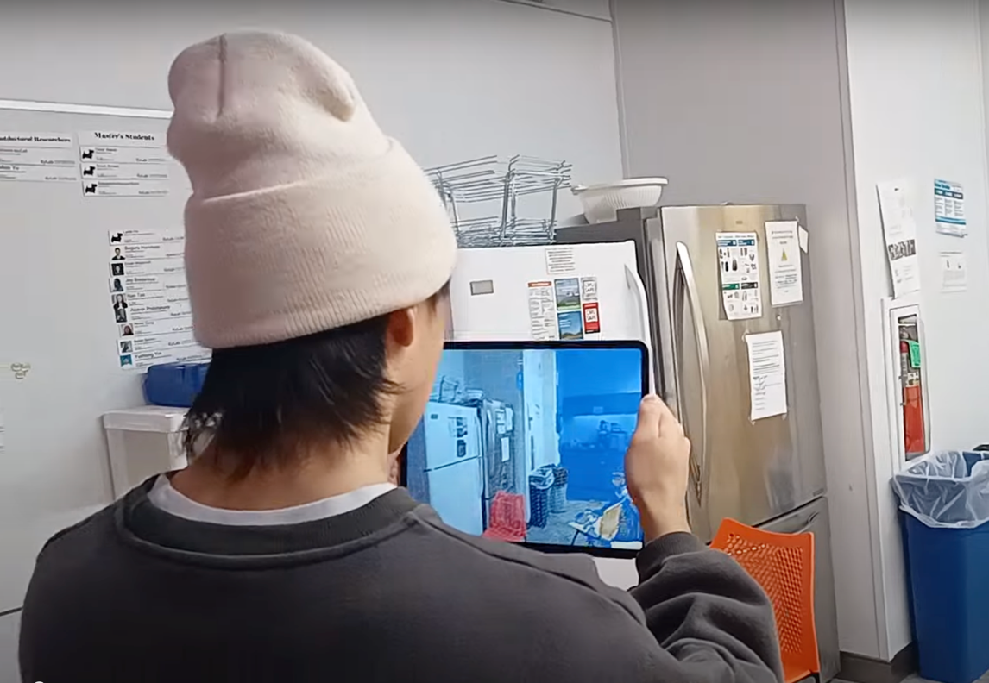
Why do maps today not have ubiquitous coverage?
Huge manual cartography effort.
Many indoor spaces are private.
Indoor maps are dynamic.
Indoor data collection is hard
Crowdsourcing on a central system is not the right way to scale
Outdoor cartography
Indoor cartography
Notes:
First, indoor data collection is hard.
For public outdoor spaces, you can scalably collect data with cars, planes, and satellite images. Indoor spaces require huge manual cartography efforts to be mapped.
Private indoor spaces require organizations to acquire explicit permissions before scanning them.
Indoor maps are also very dynamic (e.g., store inventory) and require constant updating.
Now you might say crowdsourcing indoor data is a straightforward solution to these problems. And you are right.

Slide 14
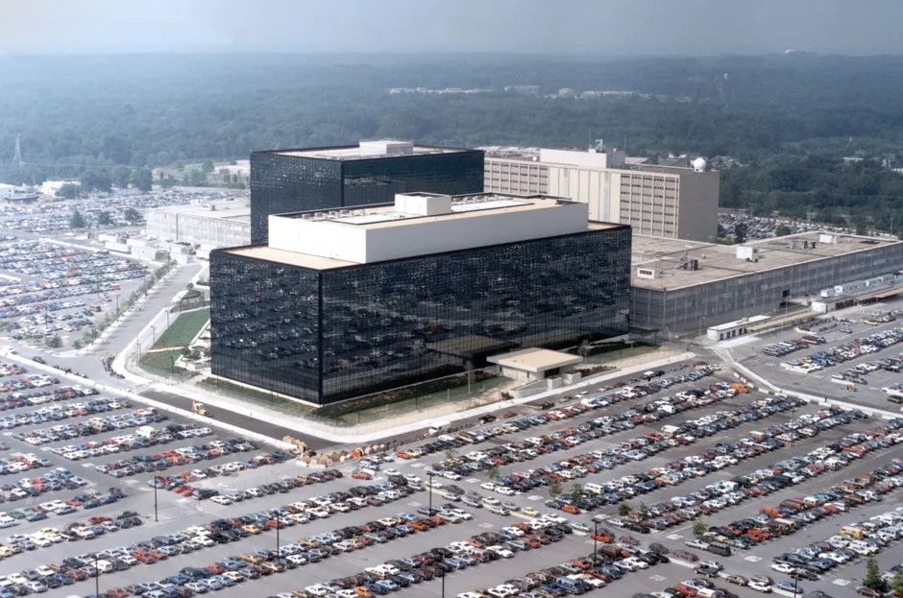

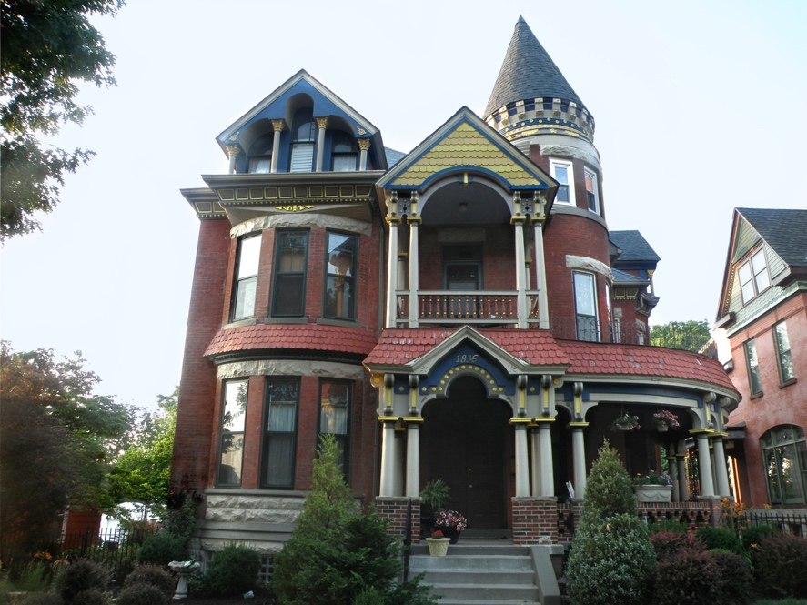
Why do maps today not have ubiquitous coverage?
Businesses do not want to expose their indoor map data due to privacy and competition concerns.
Indoor data collection is hard
Crowdsourcing on a central system is not the right way to scale
NSA
CMU CIC
Single Family Home
Notes:
Crowdsourcing can improve the scale of coverage.
However, businesses do not want to expose their indoor map data due to privacy and competition concerns.

Slide 15
Federation of Maps
Independent organizations maintain their own maps of their own spaces.
Notes:
Our solution is to federate maps so that independent organizations can maintain maps of their own spaces.

Slide 16
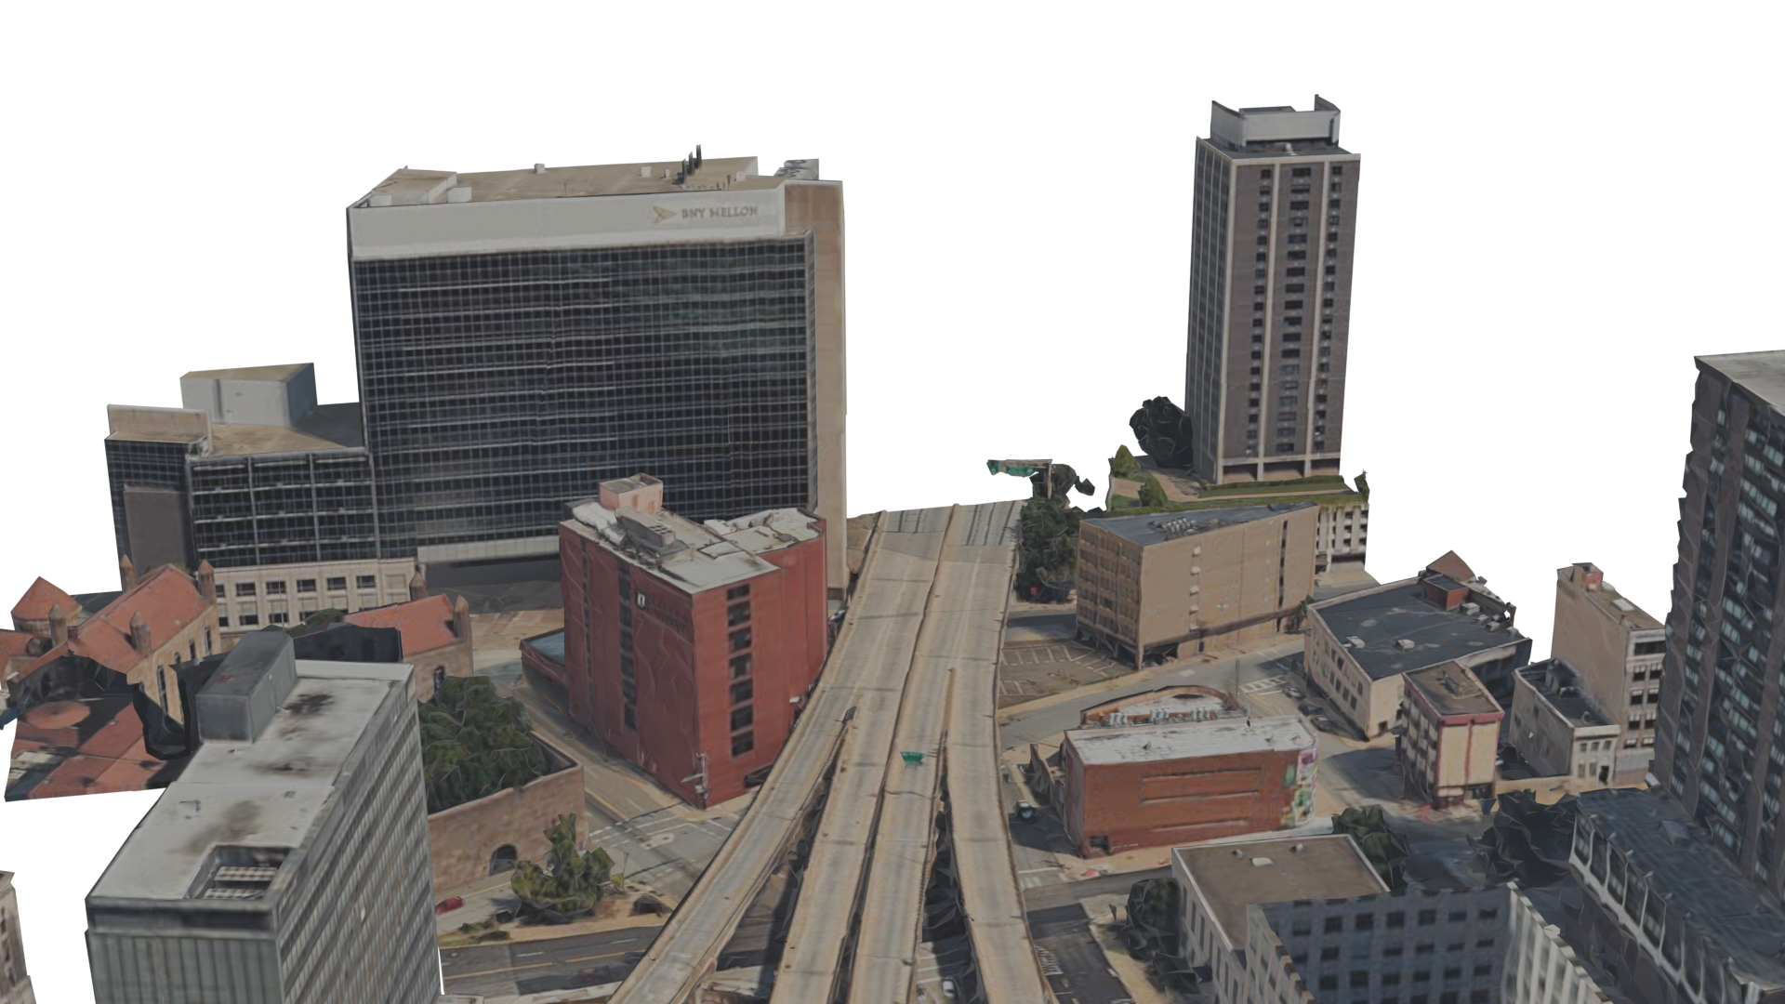
Federation of Maps
Notes:
For example, consider setting up a map for this portion of the city.

Slide 17
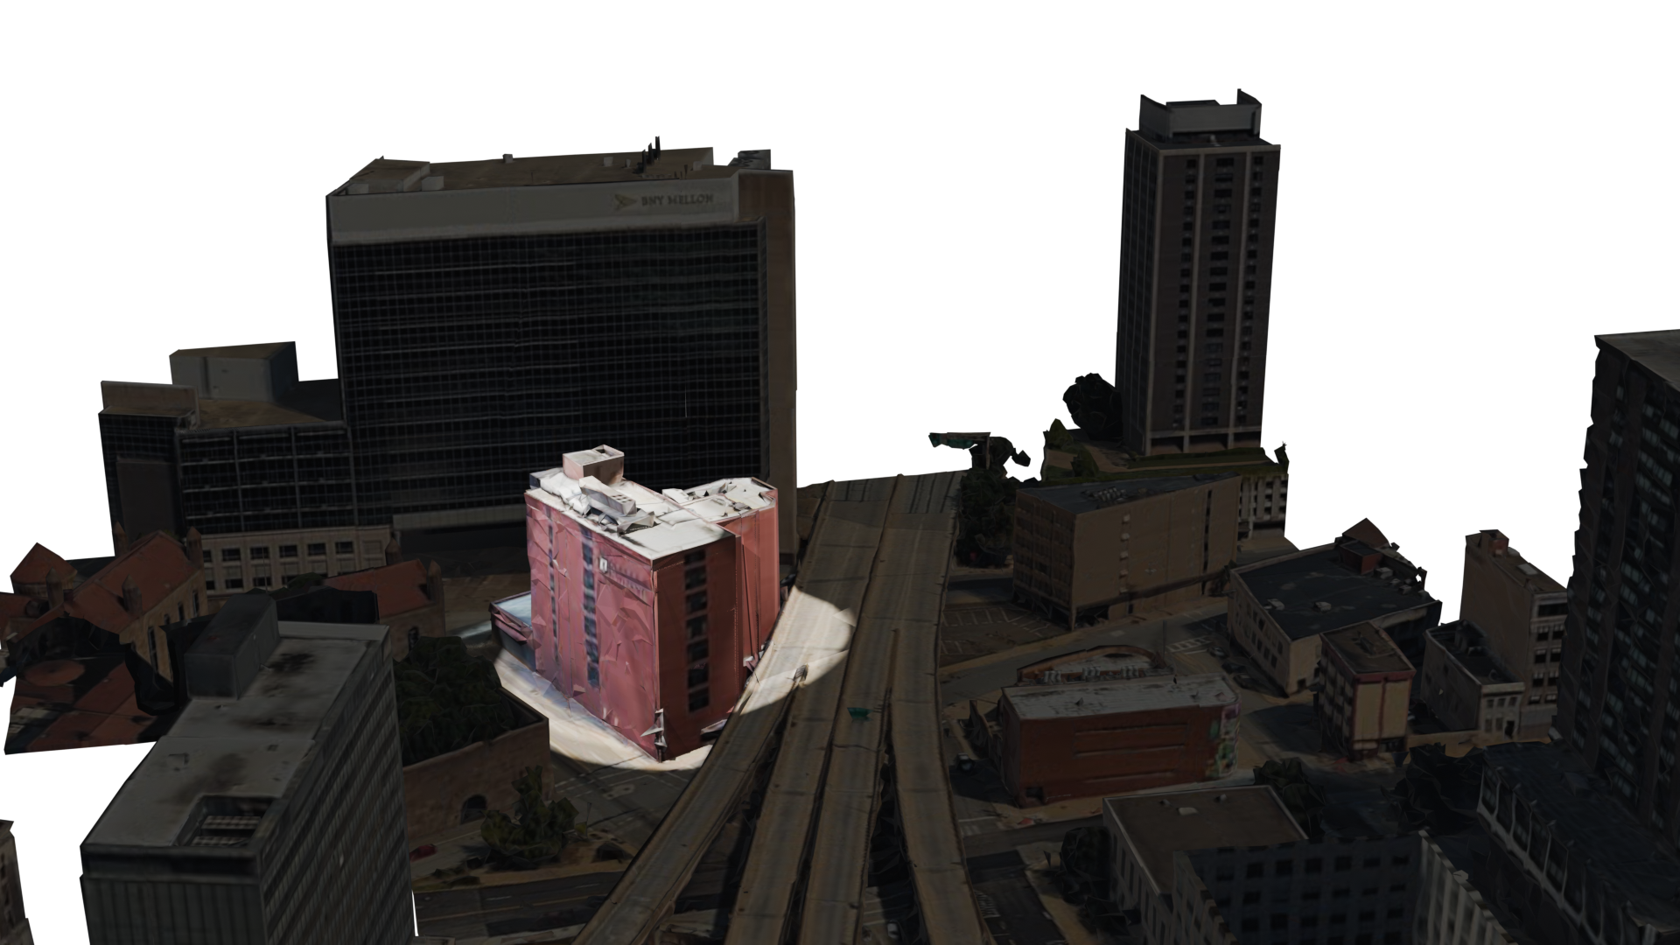

Federation of Maps
target-maps.com
Notes:
In OpenFLAME, a shopping complex can have its own map.

Slide 18
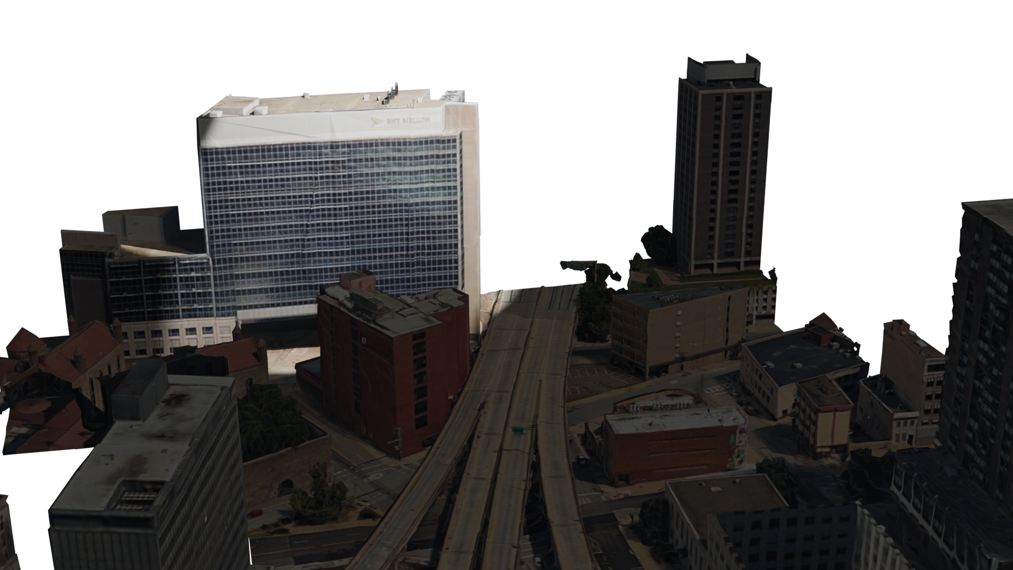

Federation of Maps
maps.cmu.edu
Notes:
So can a university.

Slide 19
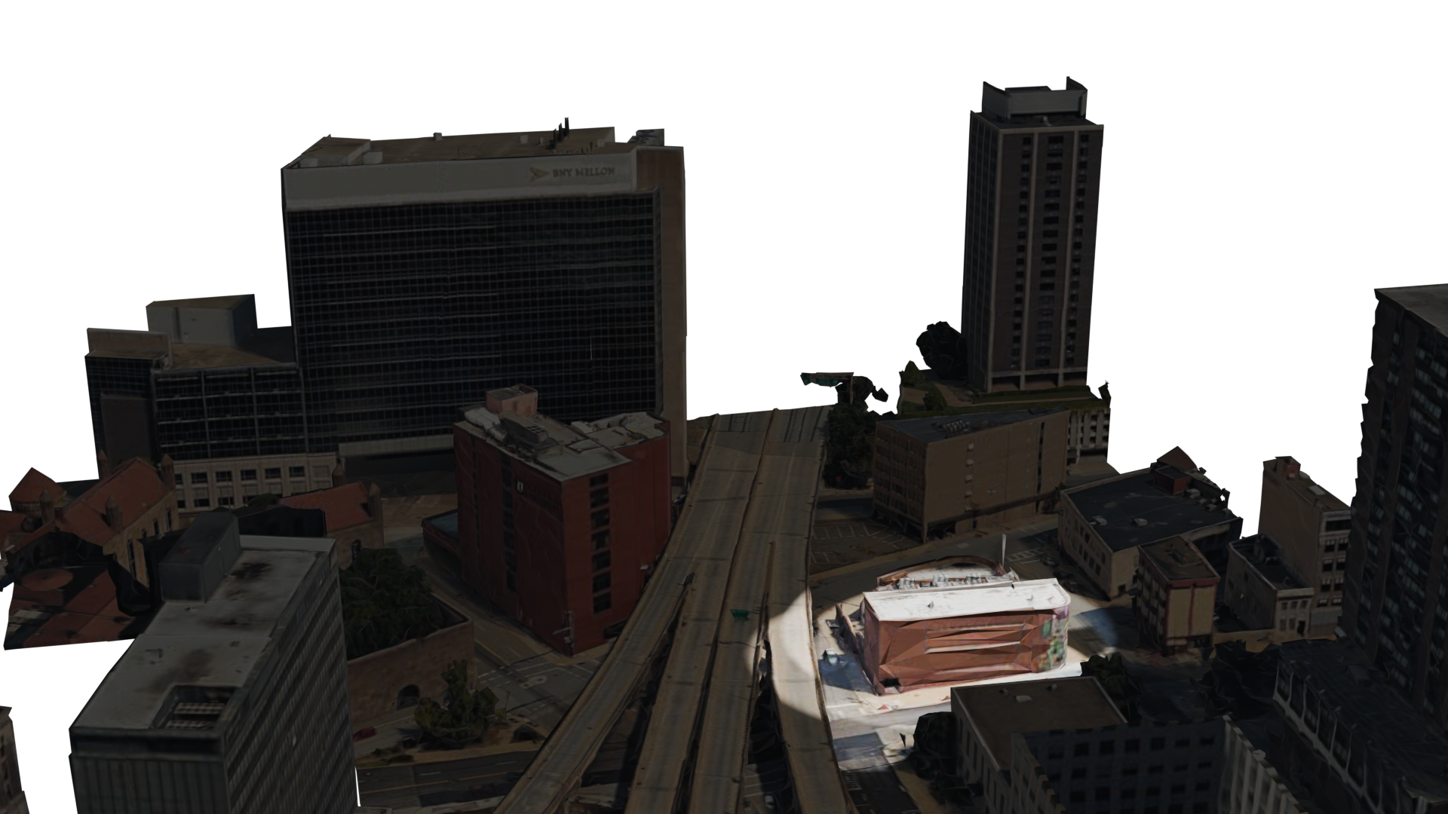

Federation of Maps
maps.art.com
Notes:
And so can a museum.

Slide 20
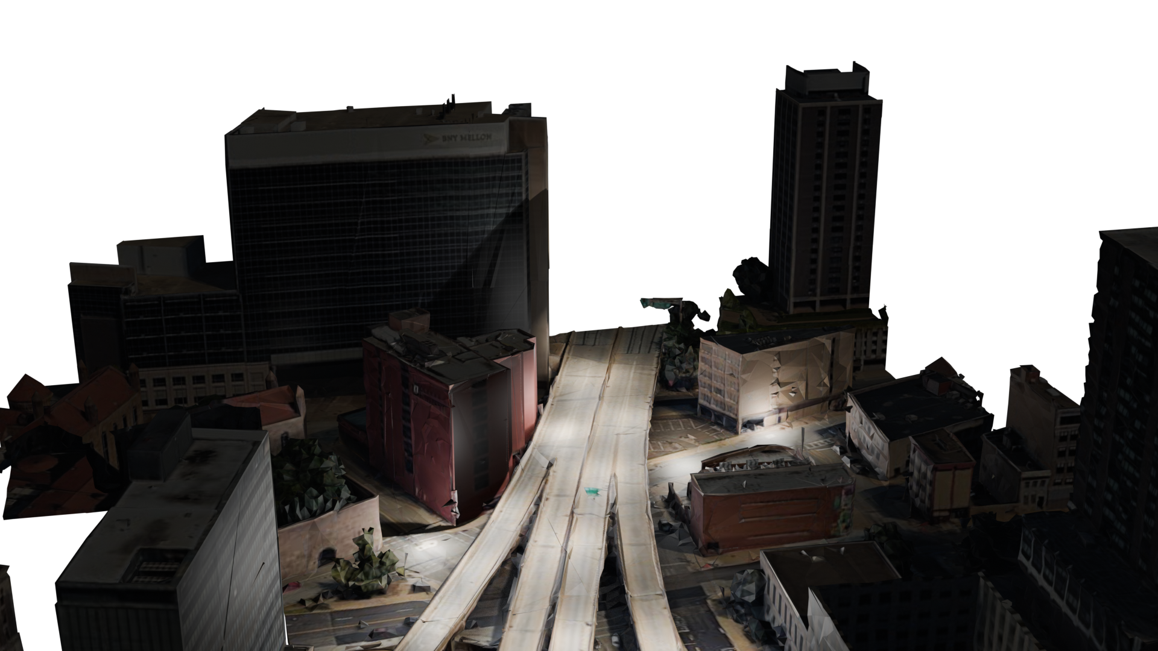

Federation of Maps
maps.google.com
Notes:
Outdoor public spaces can continue to be served by large map providers of today like Google.

Slide 21

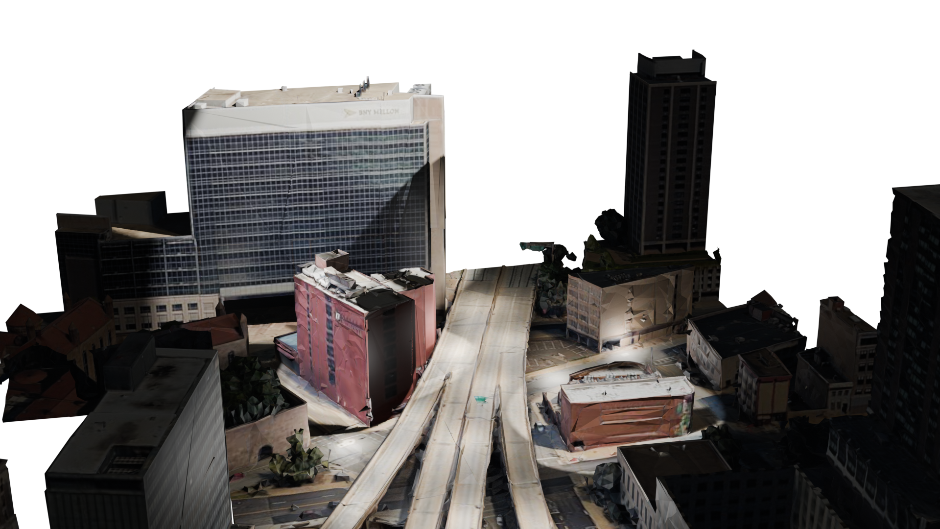
Federation of Maps
maps.cmu.edu
Ties maps together
target-maps.com
maps.art.com
maps.google.com
Notes:
OpenFLAME acts as a glue to connect multiple such maps, across indoor and outdoor spaces, to provide spatial applications with a seamless naming service.

Slide 22

Example Application: Shopping Navigator
Sagar’s Office, Carnegie Mellon
Apple Pickup, Target
Notes:
While google maps can continue to resolve parts of the name, we can resolve the other parts using smaller independent maps like Target and CMU maps.

Slide 23



Example Application: Shopping Navigator
Sagar’s Office, Carnegie Mellon
Apple Pickup, Target
Target Maps
CMU Maps
Google Maps
Notes:
While google maps can continue to resolve parts of the name, we can resolve the other parts using smaller independent maps like Target and CMU maps.

Slide 24
Design—a Centralized Spatial Naming System
maps.cmu.edu
Geocoding / Reverse geocoding
Map data
Google Maps
Geocoding: Convert addresses to corresponding geographic coordinates.
Notes:
Before we look at the design of OpenFLAME, I want to clarify the design of a centralized spatial naming system, like Google maps.
Google maps is powered by the map data collected and stored by Google. The map data in combination with the geocoding service, which is the service that converts addresses to geographic coordinates and vice versa, forms the Google spatial naming system.

Slide 25
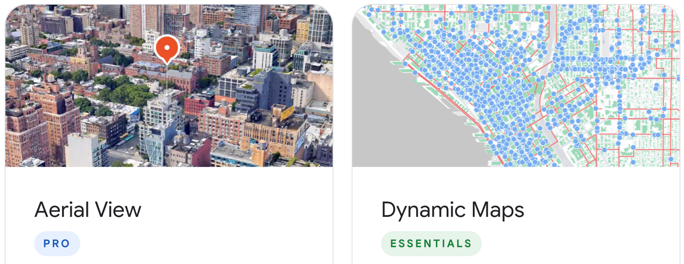
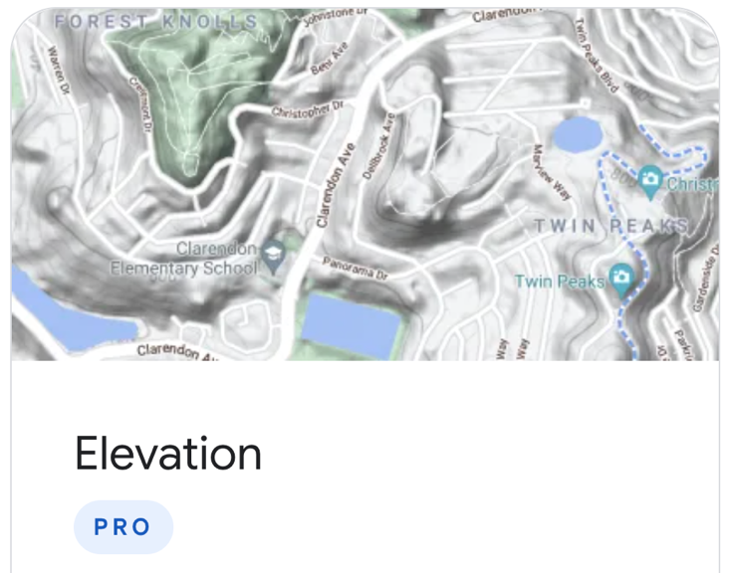
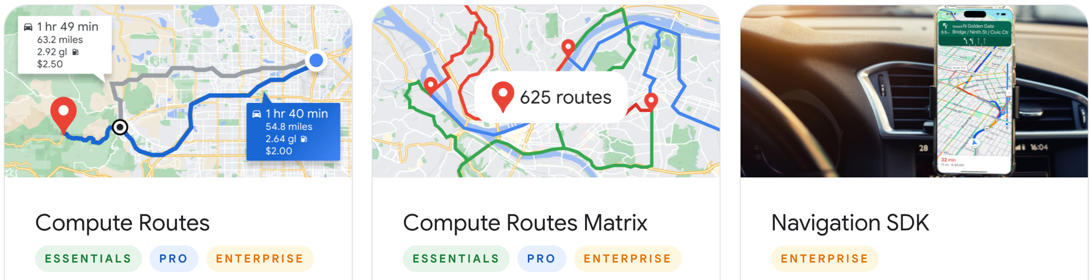
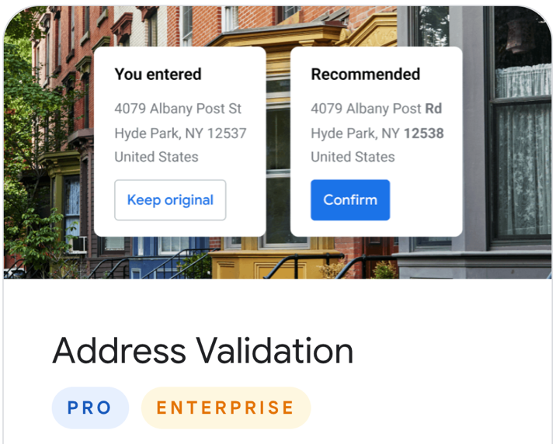
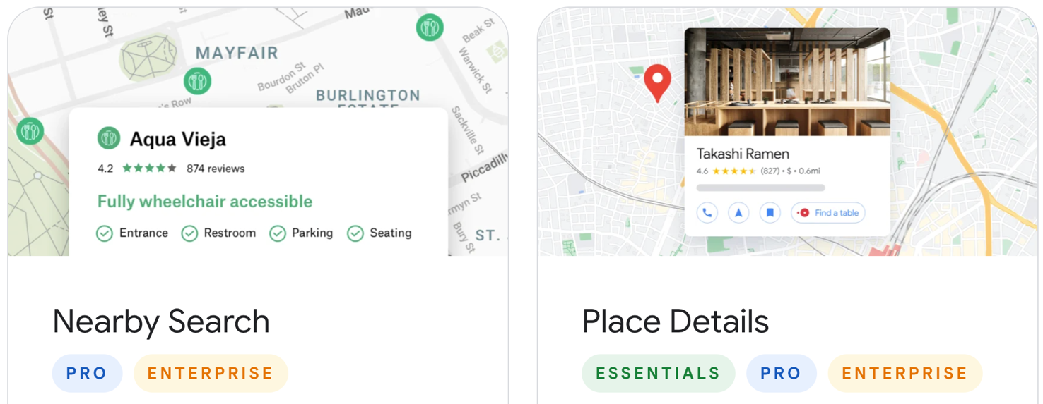
Design—a Centralized Mapping Platform
Map data
Google Maps
Notes:
In order to make this naming system useful to applications, today’s mapping platforms also provide a whole range of services on top of the map data such as multiple visualizations, route optimizations, and location-based search APIs.

Slide 26
Design—OpenFLAME Map Server
Where am I w.r.t the map?
***
How to go from A to B?
Localization
Routing
Map data
Search
Map Server
Where is A?
Visualization
A Map Server stores map data of a region and provides services on the map.
It is maintained by independent organizations.
How to visualize the map?
Notes:
To make the our spatial naming system similarly useful to spatial applications, we identify and focus on a handful of services just because most spatial applications need these basic services.
While I won’t go into the details of these services, the choice of these services does not affect in any fundamental way the design of the naming system itself.
The system that stores the map data and the services provided on top of this data is called a map server in OpenFLAME. Map servers can be maintained by independent organizations for their own spaces.

Slide 27



Design of OpenFLAME
maps.cmu.edu
Spatial database
Localization
Routing
Map data
Search
CMU Maps
Discovery
Visualization
Localization
Routing
target-maps.com
Search
Map data
Visualization
Target Maps
maps.google.com
Map data
Google Maps
Notes:
OpenFLAME is composed of multiple map servers from multiple organizations. The OpenFLAME client running on client devices discovers and contacts the necessary map servers to provide spatial naming and map-based services to the client.

Slide 28
Design—Map Servers
maps.cmu.edu
Spatial database
Localization
Routing
Map data
Search
CMU Maps
Discovery
Visualization
Localization
Routing
target-maps.com
A Map Server stores map data of a region and provides services on the map.
It is maintained by independent organizations.
Search
Map data
Visualization
Target Maps
maps.google.com
Map data
Google Maps

Slide 29
Design—Map Discovery
maps.cmu.edu
The Map Discovery system identifies the set of maps hosted for a give region.
Spatial database
Localization
Routing
Map data
Search
CMU Maps
Discovery
Visualization
Localization
Routing
target-maps.com
Search
Map data
Visualization
Target Maps
maps.google.com
Map data
Google Maps
Notes:
We need a spatial discovery system running on the client to identify relevant map servers serving a region.

Slide 30
Design—Map-based Services
maps.cmu.edu
Spatial database
Localization
Routing
Map data
Search
CMU Maps
Discovery
Visualization
Localization
Routing
target-maps.com
Search
Map data
Visualization
Target Maps
maps.google.com
Service implementations should be split between the client and map servers.
Map data
Google Maps
Notes:
Unlike in centralized maps, we need to split the

Slide 31
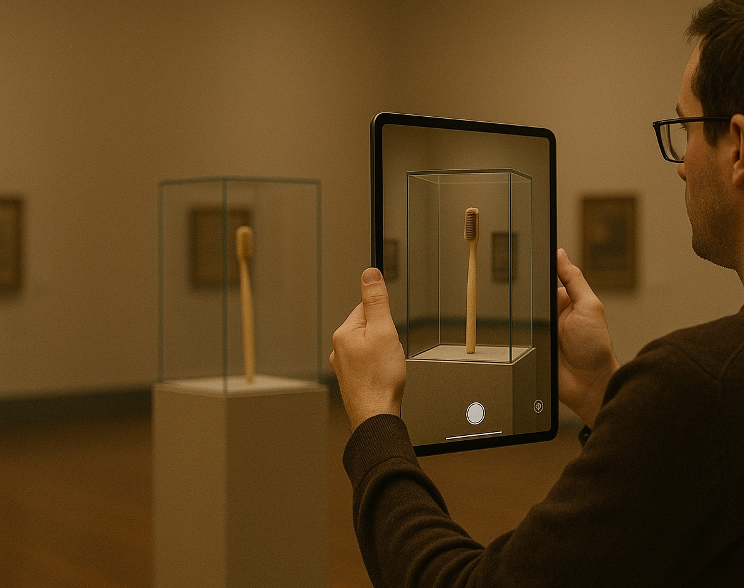
Example Application
Augmented Reality Museum
Notes:
Let us look at an example of how an application can be built on OpenFLAME. Here I am showing an example of an augmented reality content placement applications.

Slide 32



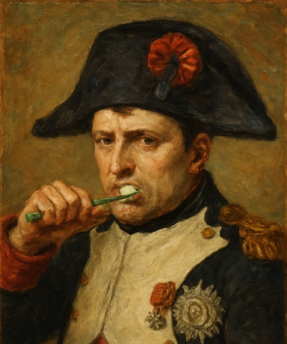
Example: Application Design
Napoleon’s Toothbrush, Carnegie Museum
AR Content Placement
1
AR Content
2
Names
Location
Carnegie Museum
Names
Spatial names | AR Content
… | …
… | …
3
Content
Localization
Content DB
Render Content
4
4
Napoleon used this toothbrush in 1815
!
OpenFLAME does not maintain content or pointers to content.
Notes:
Let us look at an example of how an application can be built on OpenFLAME. Here I am showing an example of an augmented reality content placement applications.

Slide 33
Federation offers benefits
Privacy
Fine-grained access control
Independence of services
Notes:
Provide more intuition.

Slide 34
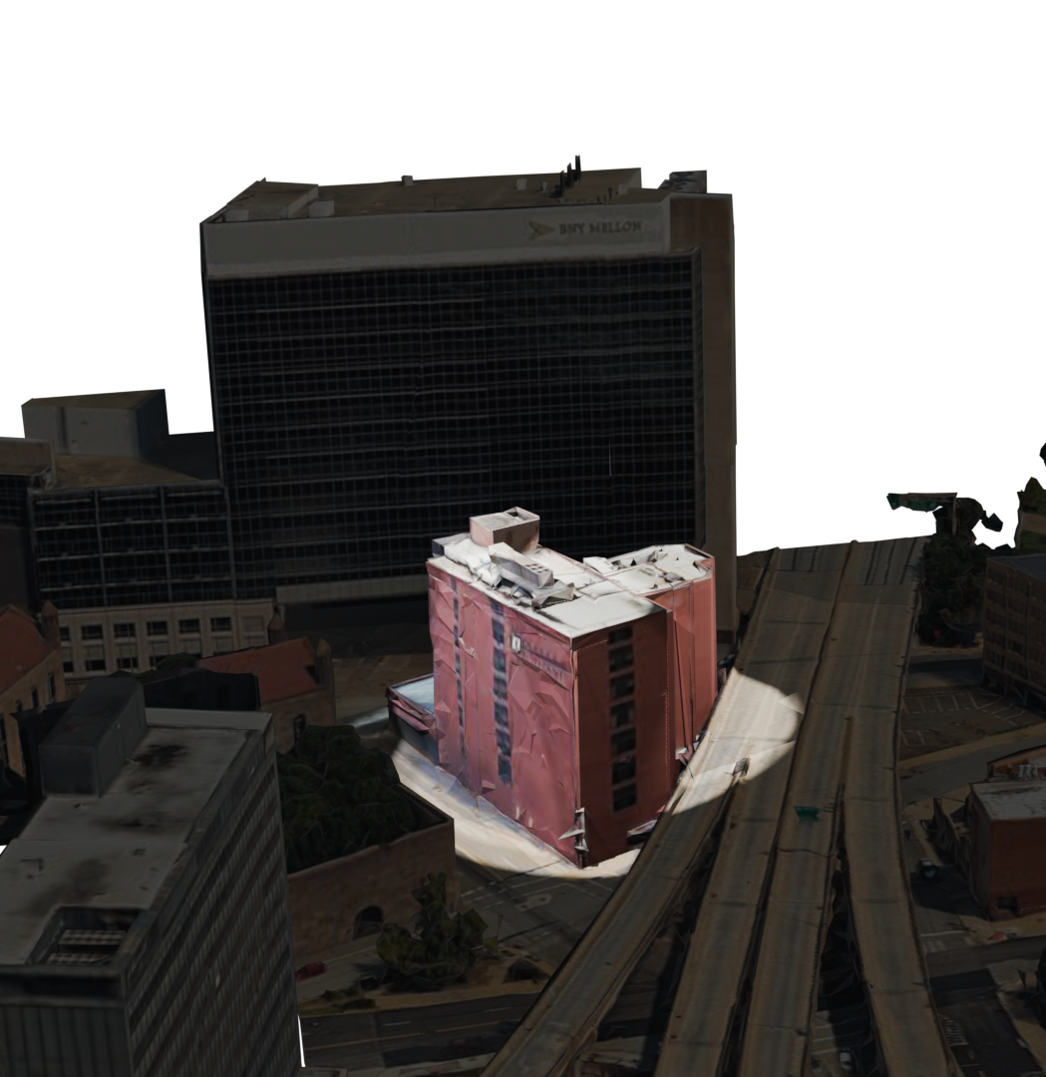
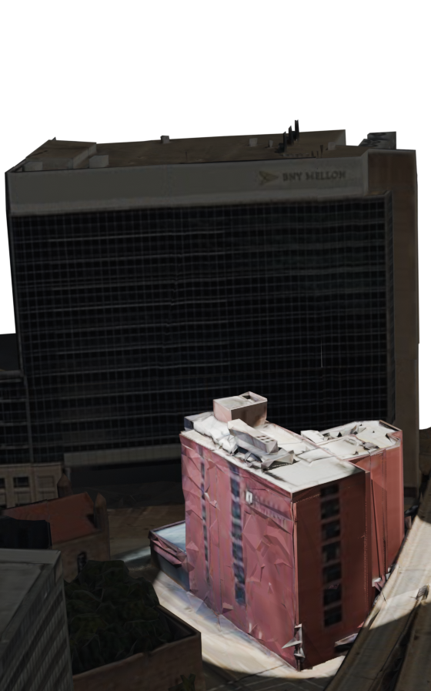
Federation offers benefits
maps.cmu.edu
Localization
Privacy
Fine-grained access control
Independence of services
Routing
Map data
Search
CMU Maps
Visualization
CMU map server
Notes:
Provide more intuition.

Slide 35
Federation offers benefits
maps.cmu.edu
Localization
Privacy
Fine-grained access control
Independence of services
Routing
Map data
Search
CMU Maps
Visualization
CMU map server

Slide 36
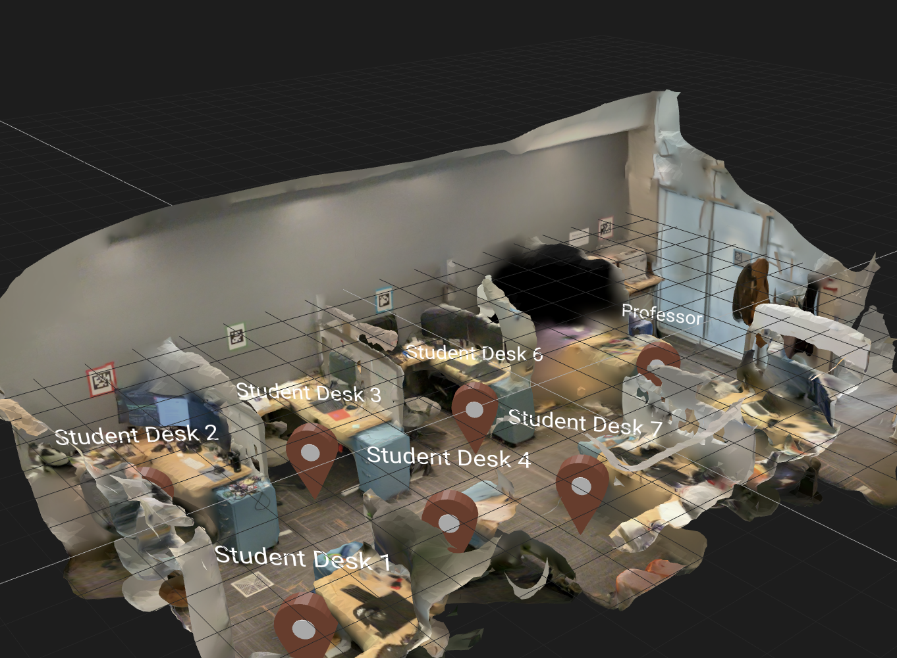
Federation offers benefits
maps.cmu.edu
Localization
Privacy
Fine-grained access control
Independence of services
Routing
Map data
Search
CMU Maps
Visualization
Private map data is stored on private servers.
Notes:
Provide more intuition.

Slide 37
Federation offers benefits
maps.cmu.edu
Localization
Privacy
Fine-grained access control
Independence of services
Routing
Map data
Search
CMU Maps
Visualization
Everybody can see the map
Only cmu.edu logins
can localize
!!
Notes:
Provide more intuition.

Slide 38
Federation offers benefits
maps.cmu.edu
Beacon-based localization
Localization
Privacy
Fine-grained access control
Independence of services
Routing
Map data
Search
CMU Maps
Visualization
maps.cmu.edu
GPS /
Image-based localization
Localization
Routing
Map data
Search
Google Maps
Visualization

Slide 39
Federation offers benefits
maps.cmu.edu
Beacon-based localization
Localization
Privacy
Fine-grained access control
Independence of services
Routing
Map data
Search
CMU Maps
Visualization
maps.cmu.edu
GPS /
Image-based localization
Localization
Routing
Map data
Search
Google Maps
Visualization
Allows faster adoption of technology fine-tuned to a map.
Notes:
Provide more intuition.

Slide 40
Challenges of Federation

Slide 41
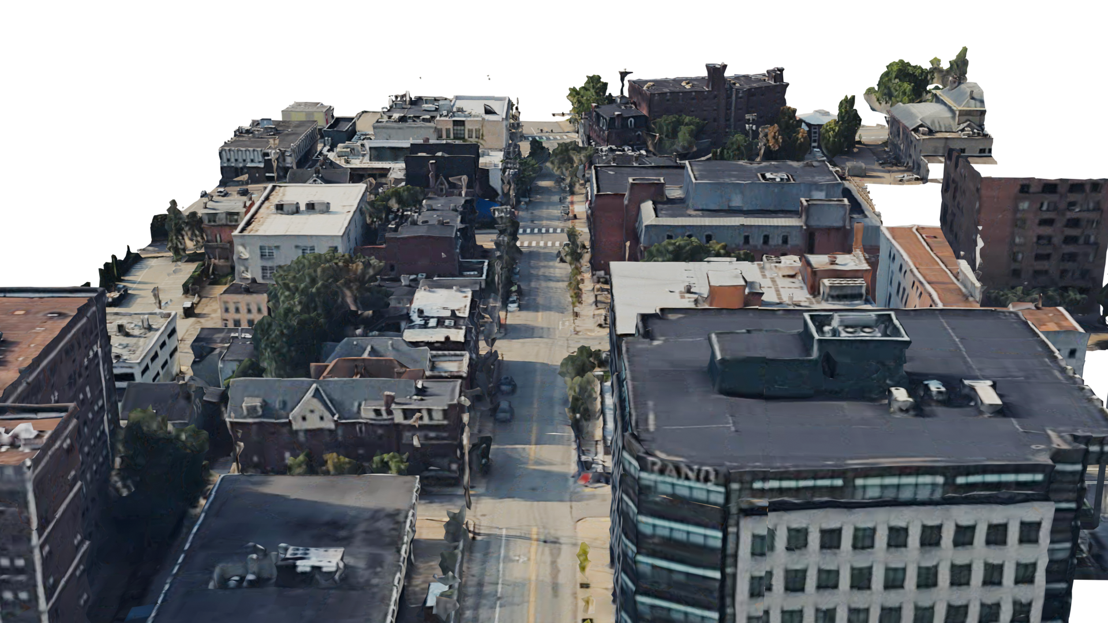
Challenges of Federation
Design of map discovery
Ranking maps
Re-architecting services
Craig street, Pittsburgh
How do we discover all maps on this street?

Slide 42
Challenges—Map Discovery

Slide 43











Challenges—Map Discovery
University police
Supercomputing
Software dept.
Indian Store
HR dept.

Slide 44
Challenges—Map Discovery
It is a large-scale problem
University police
Supercomputing
Software dept.
Map boundaries are not clear-cut
Indian Store
Needs a universally trusted infrastructure
HR dept.

Slide 45
Reusing existing trusted infrastructure—DNS
DNS has a widely deployed and trusted infrastructure with a multi-layered caching mechanism.
We can use DNS as:
Map boundaries are fuzzy.
Discovery queries do not need transaction support and ACID.
Update frequency is low.

Slide 46
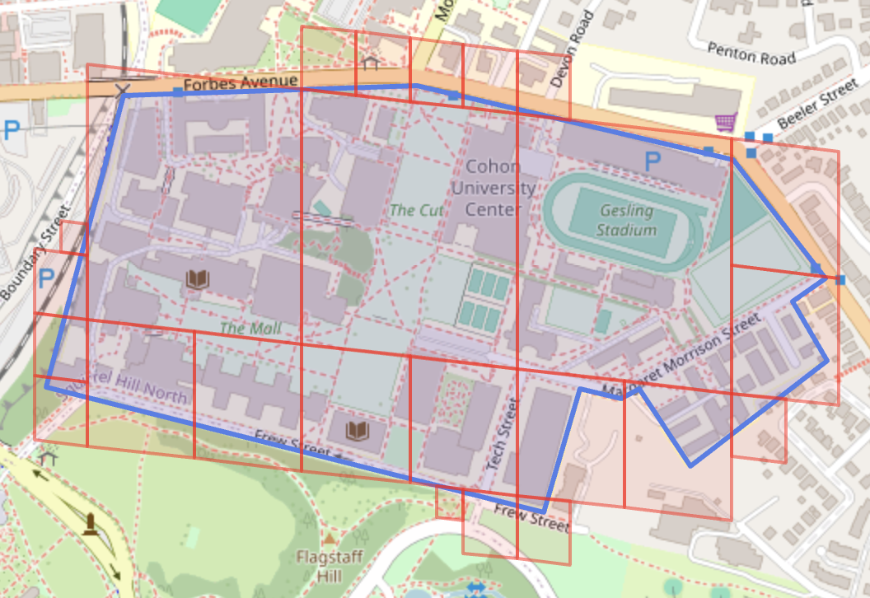
Reusing existing trusted infrastructure—DNS
DNS has a widely deployed and trusted infrastructure with a multi-layered caching mechanism.
We can use DNS as:
Map boundaries are fuzzy.
Discovery queries do not need transaction support and ACID.
Update frequency is low.

Slide 47
Reusing existing trusted infrastructure—DNS
DNS has a widely deployed and trusted infrastructure with a multi-layered caching mechanism.
We can use DNS as:
Map boundaries are fuzzy.
Discovery queries do not need transaction support and ACID.
Update frequency is low.
Discovery queries are simple spatial lookups and do not need a full-fledged database.

Slide 48
Reusing existing trusted infrastructure—DNS
DNS has a widely deployed and trusted infrastructure with a multi-layered caching mechanism.
We can use DNS as:
Map boundaries are fuzzy.
Discovery queries do not need transaction support and ACID.
Update frequency is low.
The rate at which new maps are registered in the system is relatively low compared to the rate at which existing records are read.

Slide 49
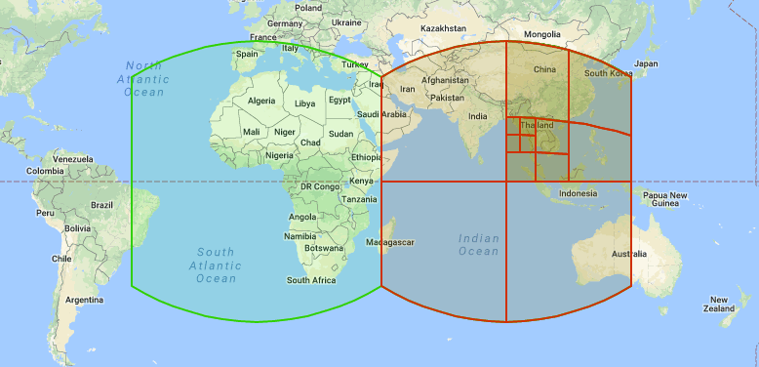
Using DNS for spatial queries
Spatial indexing systems (e.g., S2, H3) divide the world into hierarchically organized primitive shapes.
0.loc
2.2.1.loc
2.0.2.1.loc
Each primitive shape can be represented by a domain name.
Can leverage existing DNS infrastructure with modifications to the resolution process.

Slide 50
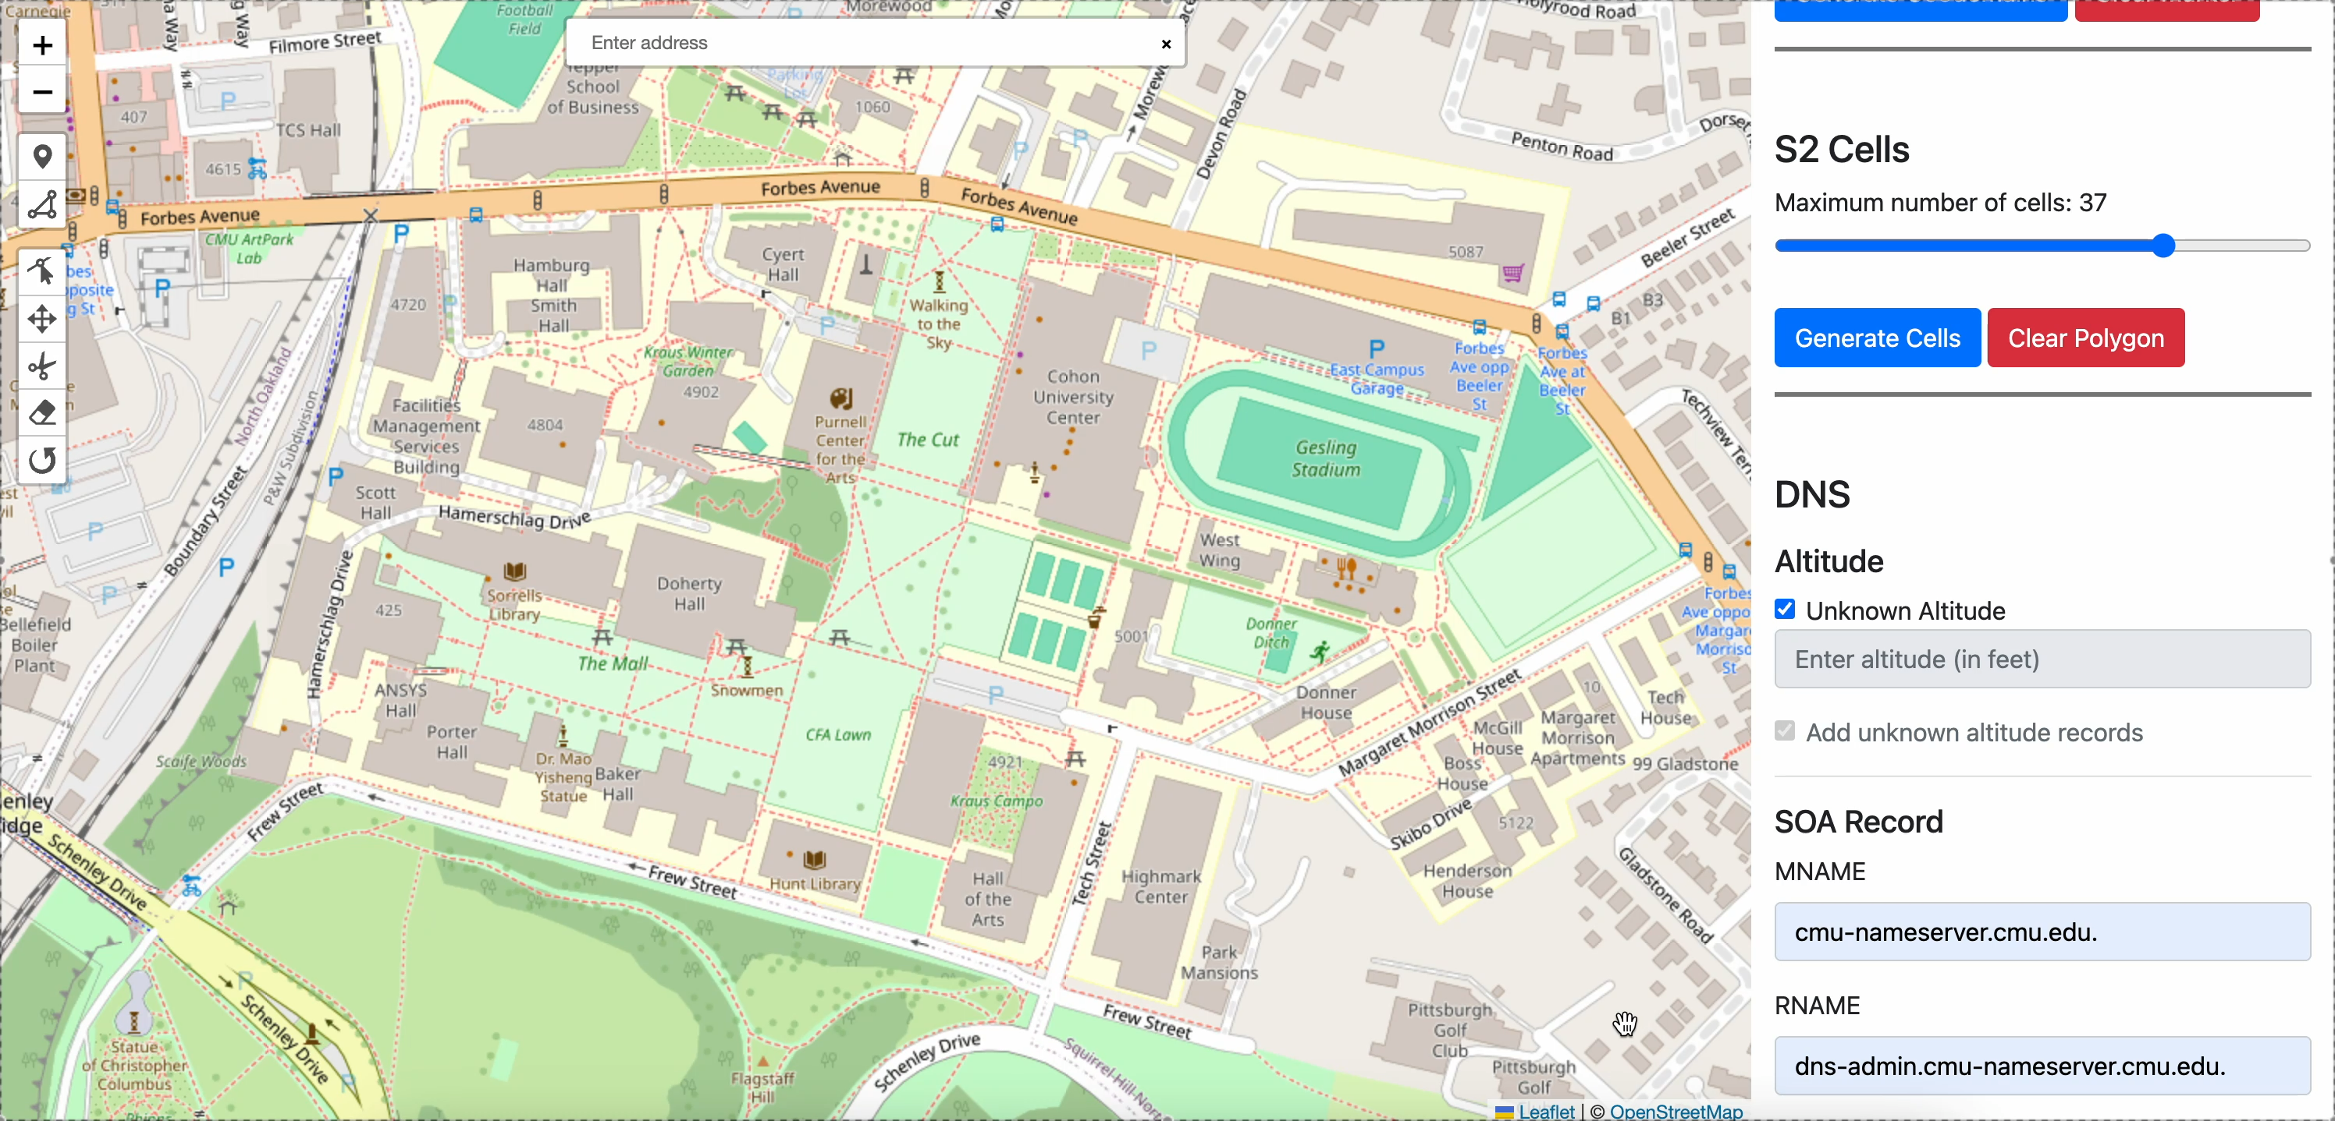
Registering regions on the DNS

Slide 51
Other Challenges
Ranking discovered Map Servers
Rearchitecting map-based services
Spatial Application design
Security and privacy implications

Slide 52

Other Challenges
Which is better?
Ranking discovered Map Servers
Rearchitecting map-based services
Spatial Application design
Security and privacy implications
CMU Maps
Student Maps

Slide 53
Other Challenges
How to implement services across client and map servers?
Ranking discovered Map Servers
Rearchitecting map-based services
Spatial Application design
Security and privacy implications

Slide 54
Other Challenges
Common design principles across applications?
Ranking discovered Map Servers
Rearchitecting map-based services
Spatial Application design
Security and privacy implications

Slide 55
Other Challenges
Ranking discovered Map Servers
Rearchitecting map-based services
Spatial Application design
Security and privacy implications
What are the attack surfaces and how can we deal with them?

Slide 56
To conclude…
Federated mapping is a new domain with multiple research challenges and huge potential to unlock a new class of applications.

Slide 57



Federated Maps to Enable the Spatial Web
www.open-flame.com
Sagar Bharadwaj
Anthony Rowe
Srinivasan Seshan
Notes:
I present OpenFLAME, a federated map system we’re building at CMU.

Slide 58
Backup

Slide 59
Can centralized maps offer the same benefits?
Yes (with the right incentive structure and business models)
But, handing all maps of the world to a handful of organizations leads to issues
Vendor lock-in and fragmentation
Excessive dependency
Notes:
Make back up slides.

Slide 60

Example: Application Design
AR Content Placement
Names at device location
Spatial names | AR Content
… | …
… | …
Localization
Content DB
Render Content
!
OpenFLAME does not maintain content or pointers to content.

Slide 61

Example: Application Design
Smart Home
Names at device location
Spatial names | Smart device control parameters
… | …
… | …
Smart device DB
Control Smart device
!
OpenFLAME does not maintain content or pointers to content.

Slide 62




Existing systems can be used
Spatial Databases and Geographic Information systems
But this requires deploying a new infrastructure and establishing a source of trust that all Spatial Applications can use.
Notes:
Remove this slide

Slide 63
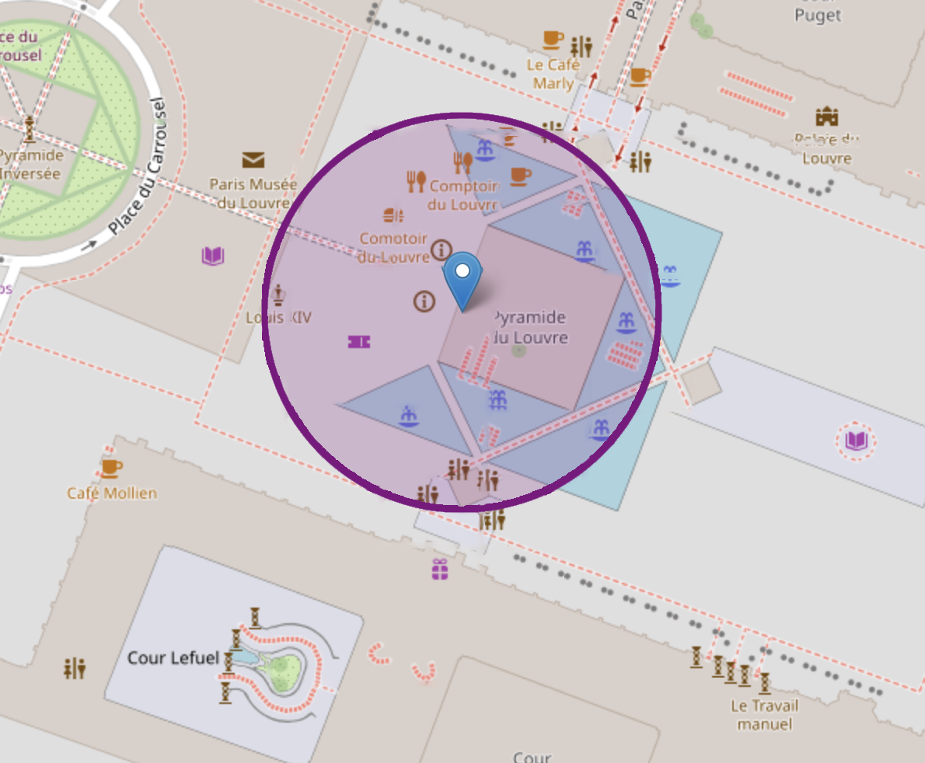
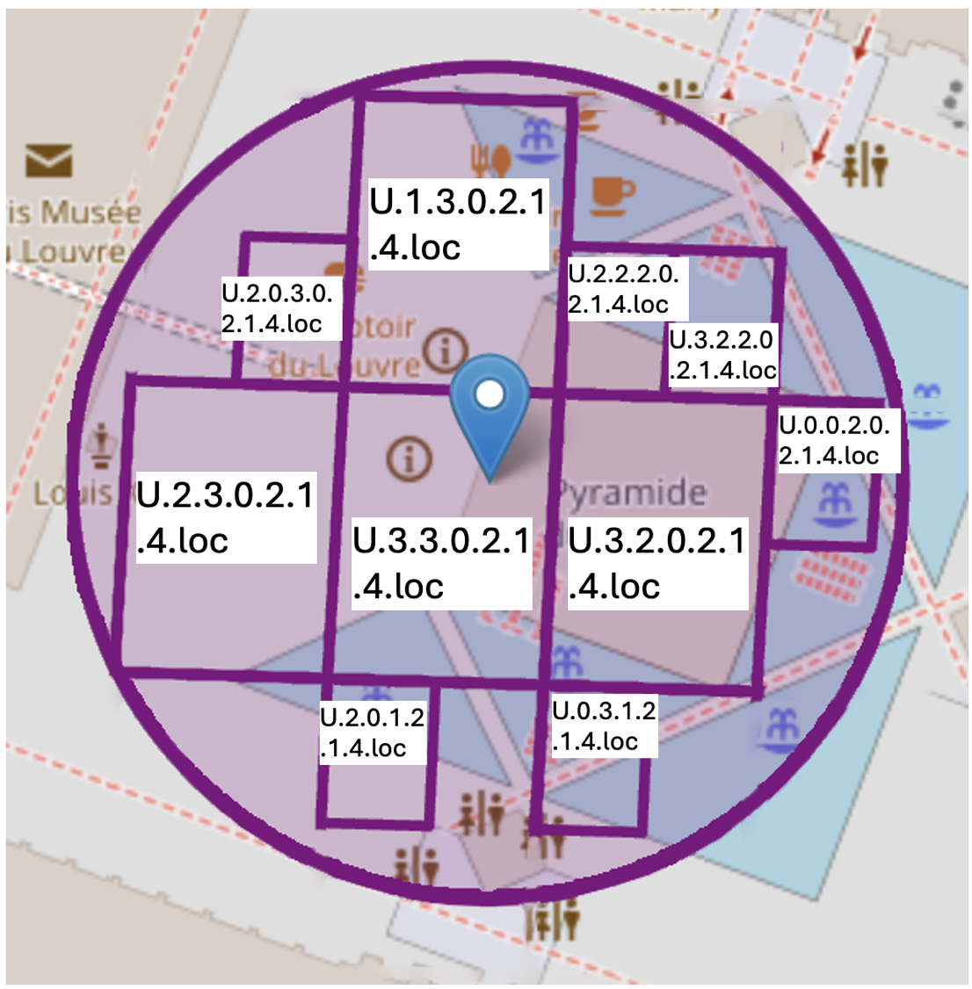
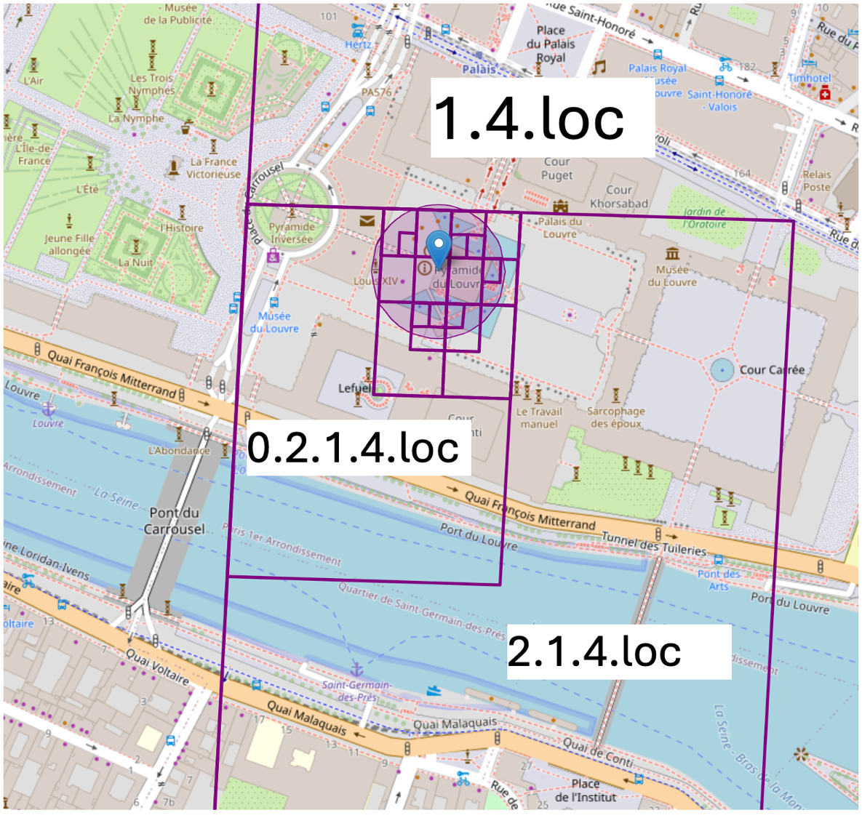
Using DNS for spatial queries
Domains corresponding to the location are queried
Parent domains are queried for bigger maps
Location and error estimate
Notes:
Skip
Zoom out video -- loop

Slide 64
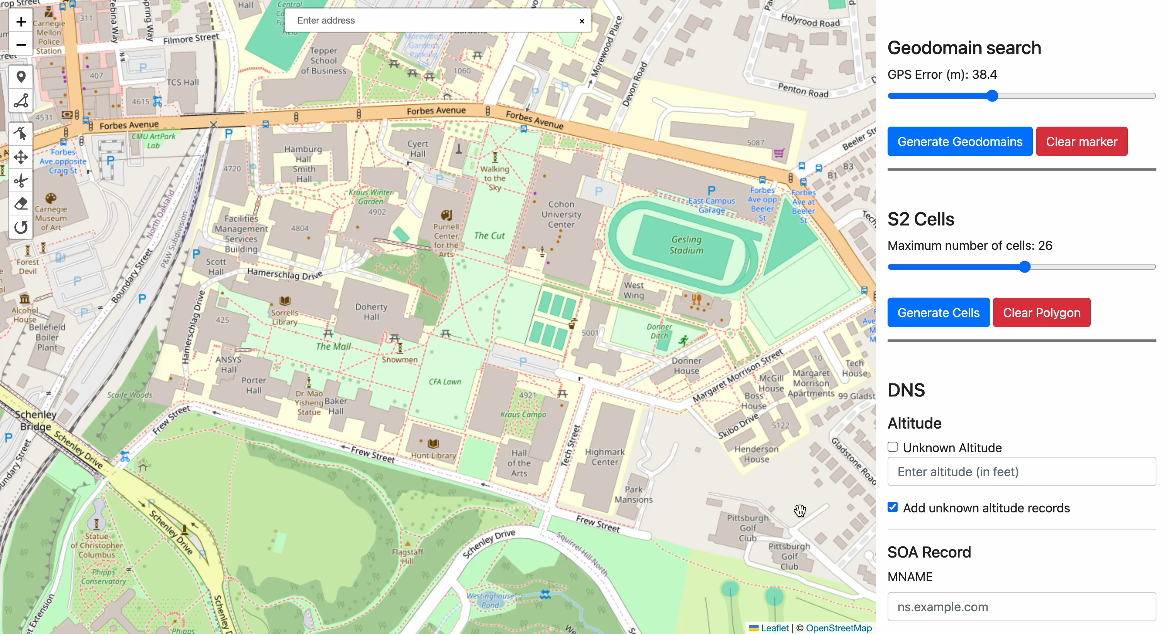
Using DNS for spatial queries
Notes:
Skip

Slide 65
Challenges of Federation
Design of map discovery
Ranking maps
Re-architecting services
At a given location, many maps may be discovered. How do we determine which is the right one to use?
Notes:
Give a picture example. Example, craig street CMU, Pitt, etc.
Put the two challenges at the end

Slide 66
Challenges of Federation
Design of map discovery
Ranking maps
Re-architecting services
Map-based services such as routing need to be re-designed to work across multiple maps.
Notes:
Concrete examples of the services. Give examples from Google maps

